Slide 1
Reachability Variants (Optional)

Slide 2
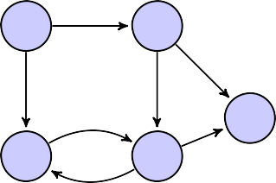
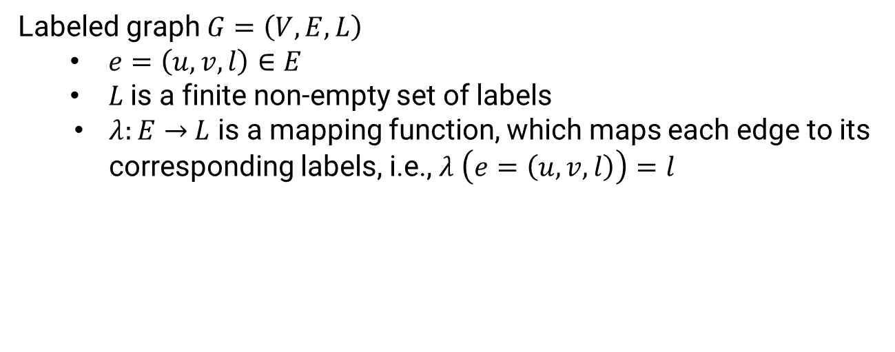
Labeled Graphs
Labeled graph $G=\left(V,E, L\right)$
$e=\left(u,v,l\right)∈E$
$L$is a finite non-empty set of labels
$λ:E→$ $L$ is a mapping function, which maps each edge to its corresponding labels, i.e., $λ \left(e=\left(u,v,l\right)\right)=l$
friendOf
Example of Labeled Graphs:
social networks (e.g., LinkedIn, Facebook)
scientific networks (e.g., Uniprot, PubChem)
knowledge graphs (e.g., DBPedia, MS Academic Graph)
transportation and utility networks
.,. ...
v
1
v
2
friendOf
likes
friendOf
follows
v₃
v₄
v₅
likes
follows
Focus is on “things” (i.e., nodes, vertices) and their relationships (i.e., labeled directed edges)

Slide 3
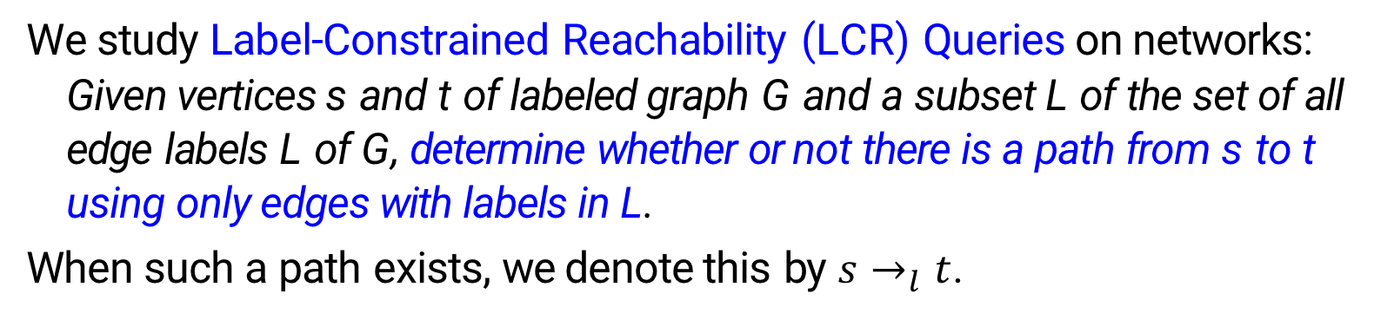
Label-constrained Reachability
We study Label-Constrained Reachability (LCR) Queries on networks:
Given vertices s and t of labeled graph G and a subset L of the set of all edge labels L of G, determine whether or not there is a path from s to t using only edges with labels in L.
When such a path exists, we denote this by $s→_{l}t$.
Valstar, L.D., Fletcher, G.H. and Yoshida, Y., 2017, May. Landmark indexing for evaluation of label-constrained reachability queries. In Proceedings of the 2017 ACM International Conference on Management of Data (pp. 345-358).

Slide 4
Label-constrained Reachability
friendOf
v
1
v
2
Example. The query
(v₁, v₅, {friendOf}) is true.
The query
(v₁, v₃, {friendOf}) is false.
friendOf
likes
friendOf
follows
v₃
v₄
v₅
likes
follows
LCR Queries
Natural generalization of reachability queries.
An important fragment of the language of regular path queries.
Implemented in W3C’s SPARQL 1.1, Neo4j’s Cypher, and Oracle’s PGQL.

Slide 5
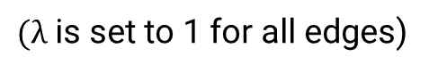
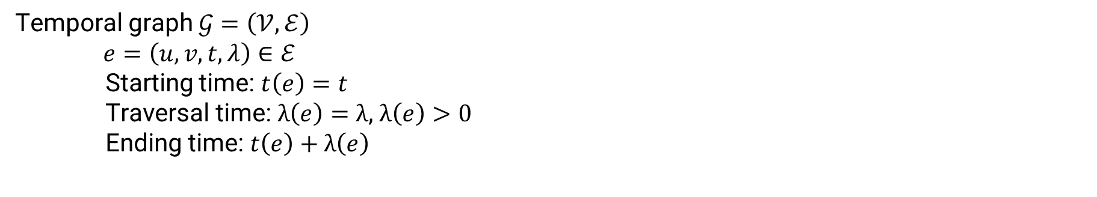
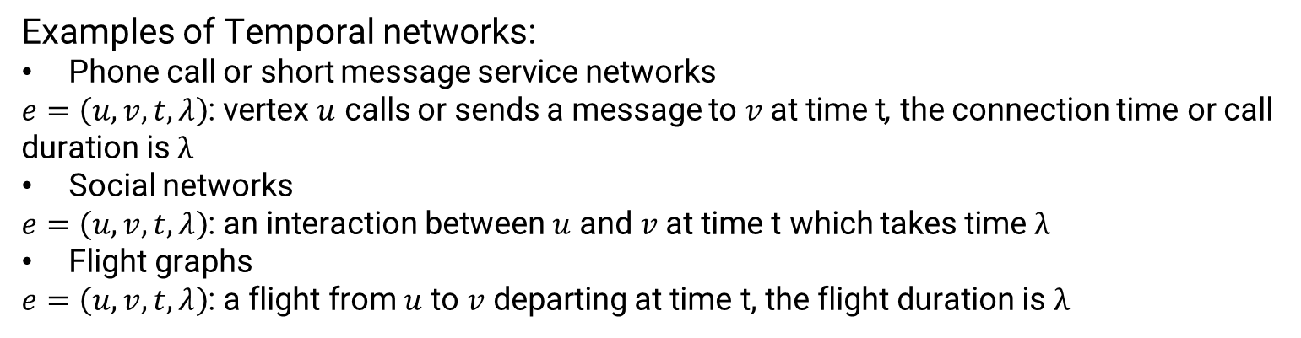
Temporal Graphs
a
1
2
4
3
b
c
d
3
6
5
10
Temporal graph $𝒢=\left(𝒱,ℰ\right)$
$e=\left(u,v,t,λ\right)∈ℰ$
Starting time: $t\left(e\right)=t$
Traversal time: $λ\left(e\right)=λ$, $λ\left(e\right)>0$
Ending time: $t\left(e\right)+λ\left(e\right)$
e
f
g
7
9
8
h
i
Temporal Graph
$(λ$ is set to 1 for all edges)
Examples of Temporal networks:
Phone call or short message service networks
$e=\left(u,v,t,λ\right)$: vertex $u$ calls or sends a message to $v$ at time t, the connection time or call duration is $λ$
Social networks
$e=\left(u,v,t,λ\right)$: an interaction between $u$ and $v$ at time t which takes time $λ$
Flight graphs
$e=\left(u,v,t,λ\right)$: a flight from $u$ to $v$ departing at time t, the flight duration is $λ$

Slide 6
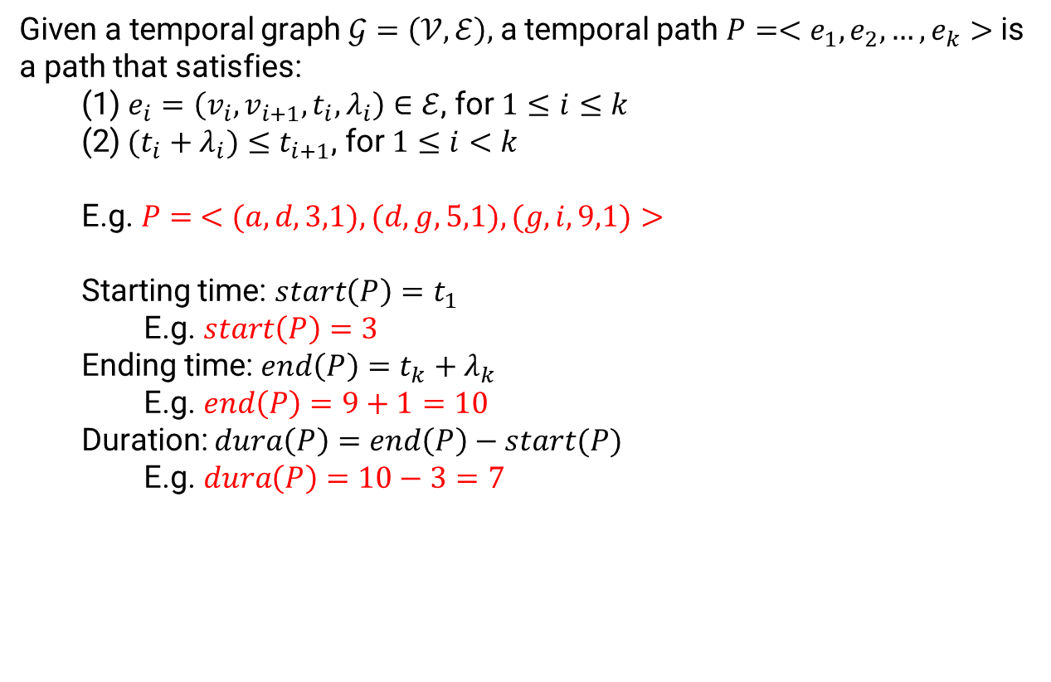

Temporal Reachability
Definitions of Temporal Path
$$λ_{i}=1 for all i$$
Given a temporal graph $𝒢=\left(𝒱,ℰ\right),$a temporal path $P=<e_{1},e_{2},…,e_{k}>$ is a path that satisfies:
(1) $e_{i}=\left(v_{i},v_{i+1},t_{i},λ_{i}\right)∈ℰ$, for $1≤i≤k$
(2)$(t_{i}+λ_{i})≤t_{i+1}$, for $1≤i<k$
E.g. $P= <(a,d,3,1),(d,g,5,1),(g,i,9,1)>$
Starting time: $start\left(P\right)=t_{1}$
E.g. $start\left(P\right)=3$
Ending time: $end\left(P\right)=t_{k}+λ_{k}$
E.g. $end\left(P\right)=9+1=10$
Duration: $dura\left(P\right)=end\left(P\right)−start(P)$
E.g. $dura\left(P\right)=10−3=7$
a
1
2
4
3
b
c
d
3
6
5
10
e
f
g
7
9
8
h
i
Temporal Graph
Wu, H., Huang, Y., Cheng, J., Li, J. and Ke, Y., 2016, May. Reachability and time-based path queries in temporal graphs. In 2016 IEEE 32nd International Conference on Data Engineering (ICDE) (pp. 145-156).

Slide 7

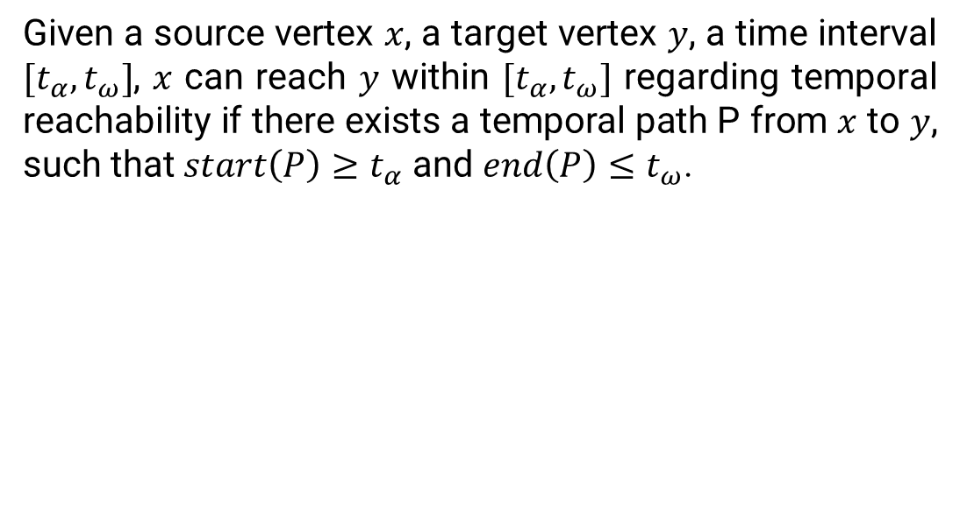
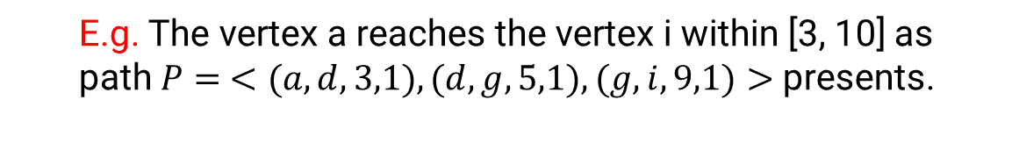
Temporal Reachability (Cont)
Definitions of Temporal Path
$$λ_{i}=1 for all i$$
Given a source vertex $x$, a target vertex $y$, a time interval $[t_{α}, t_{ω}]$, $x$ can reach $y$ within $[t_{α}, t_{ω}]$ regarding temporal reachability if there exists a temporal path P from $x$ to $y$, such that $start\left(P\right)≥t_{α}$ and $end\left(P\right)≤t_{ω}$.
a
1
2
4
3
b
c
d
3
6
5
10
E.g. The vertex a reaches the vertex i within [3, 10] as path $P= <(a,d,3,1),(d,g,5,1),(g,i,9,1)>$ presents.
e
f
g
7
9
8
h
i
Temporal Graph

Slide 8
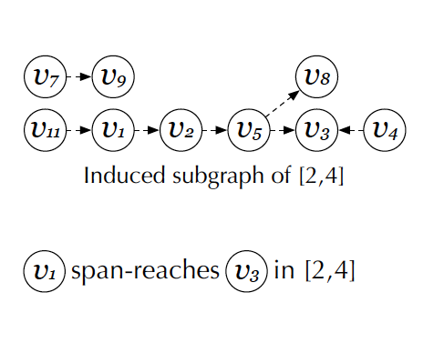
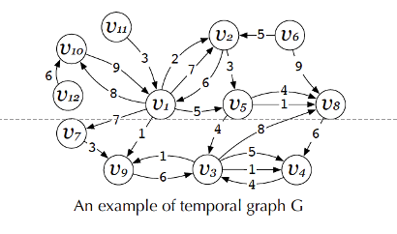
Span-Reachability (Cont)
Span-reachability Definition
Given a temporal graph G, a time interval [ts, te], a vertex u span-reaches a vertex v if u reaches v in the induced subgraph of all edges in [ts, te].
Wen, D., Huang, Y., Zhang, Y., Qin, L., Zhang, W. and Lin, X., 2020, April. Efficiently Answering Span-Reachability Queries in Large Temporal Graphs. In 2020 IEEE 36th International Conference on Data Engineering (ICDE) (pp. 1153-1164). IEEE.

Slide 9
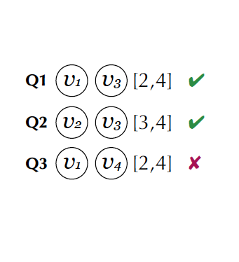
Span-Reachability
Span-reachability Definition
Given a temporal graph G, a time interval [ts, te], a vertex u span-reaches a vertex v if u reaches v in the induced subgraph of all edges in [ts, te].

Slide 10
Span-Reachability (Cont)
Applications
Security Assessment & Recommendation
People involved in the same social group
Money Transaction Monitor
money laundering & fake transactions
Biology Analysis
- Proteins involved in the same biological organization
...

